Slide 1
WIRE POWDERLESS
EE461L Team 3:
Lian Fang Liu, Mona McElroy, Rachel Tan, Sohaib Khan, Yue Cheng

Slide 2
1: Team Project
Wire Powderless
Project pdf

Slide 3
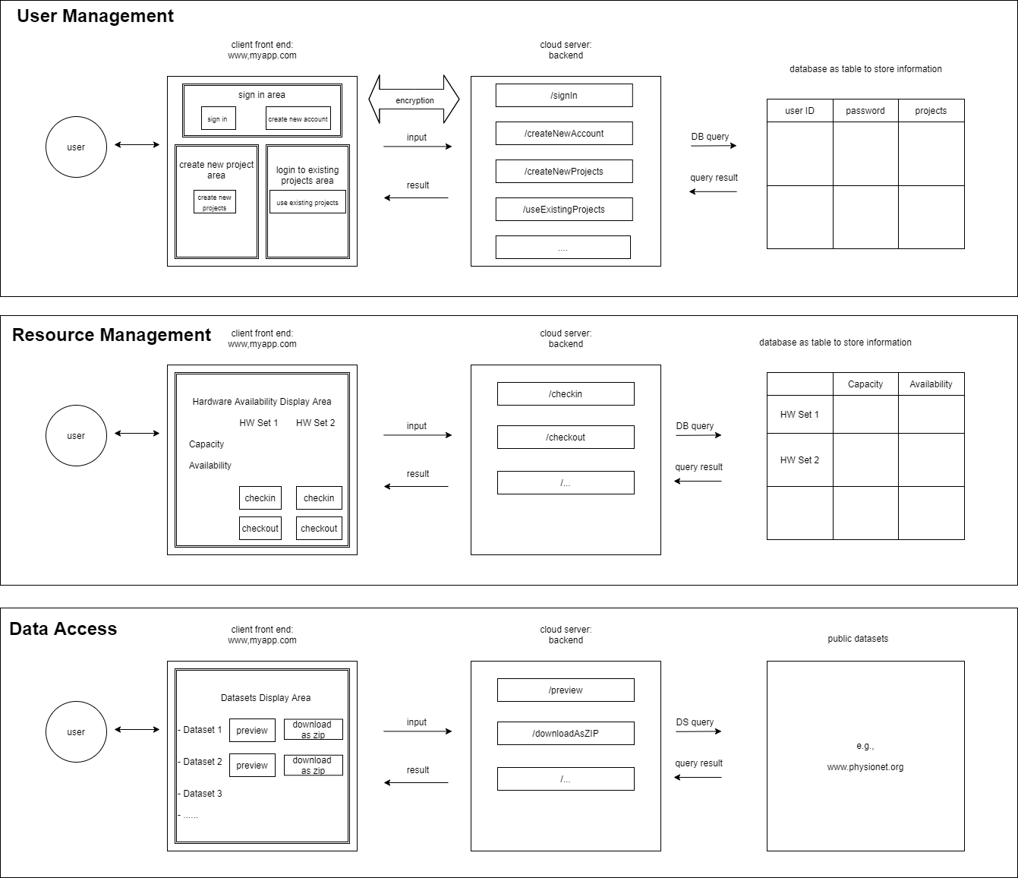
1: Team Project

Slide 4
2: SDLA, Agile, Git
Meeting Notes
Github

Slide 5
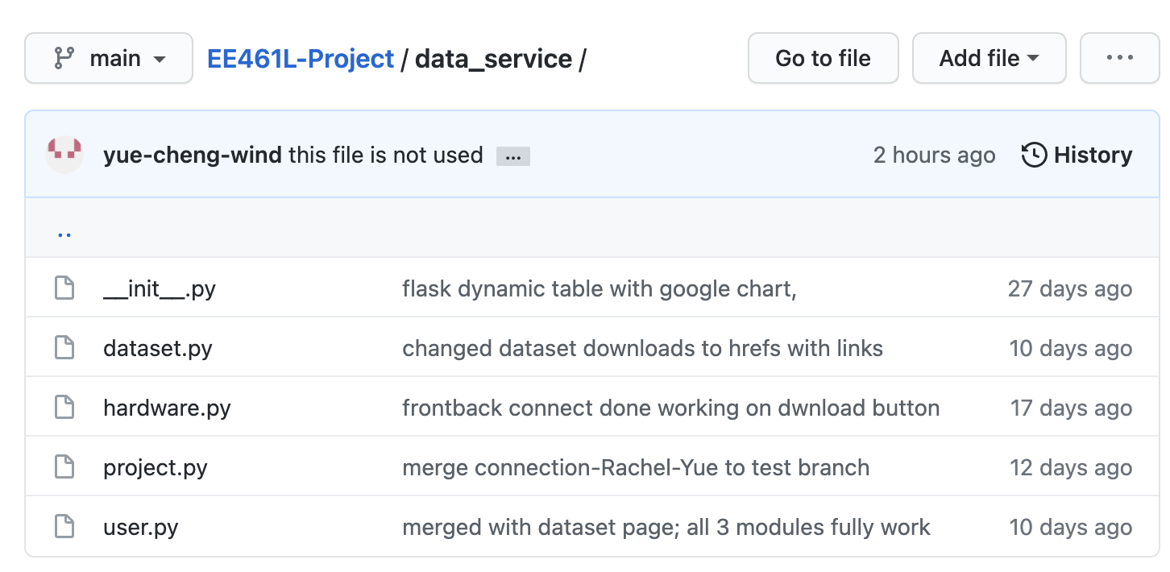
3: Python

Slide 6
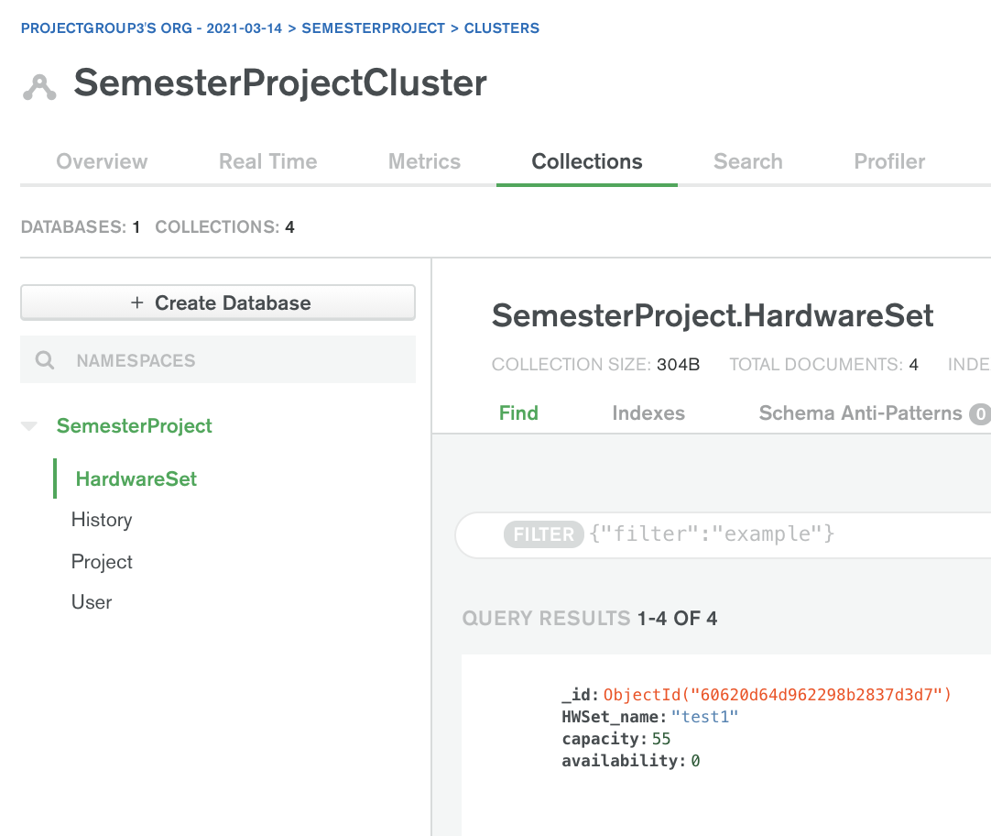
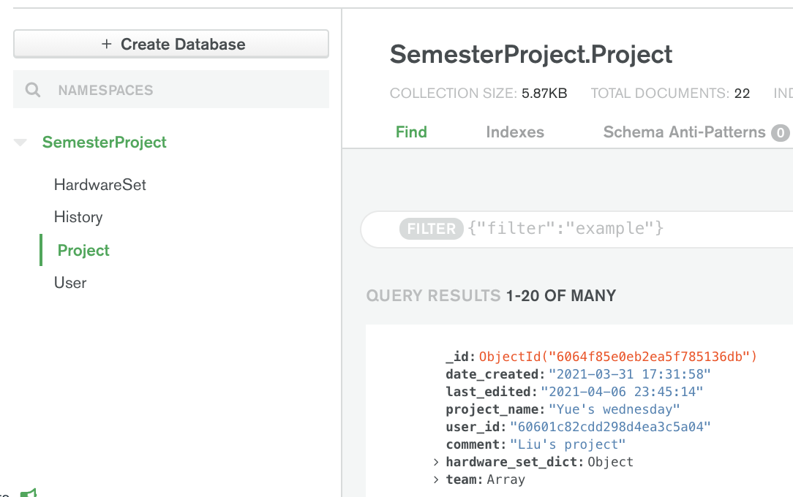
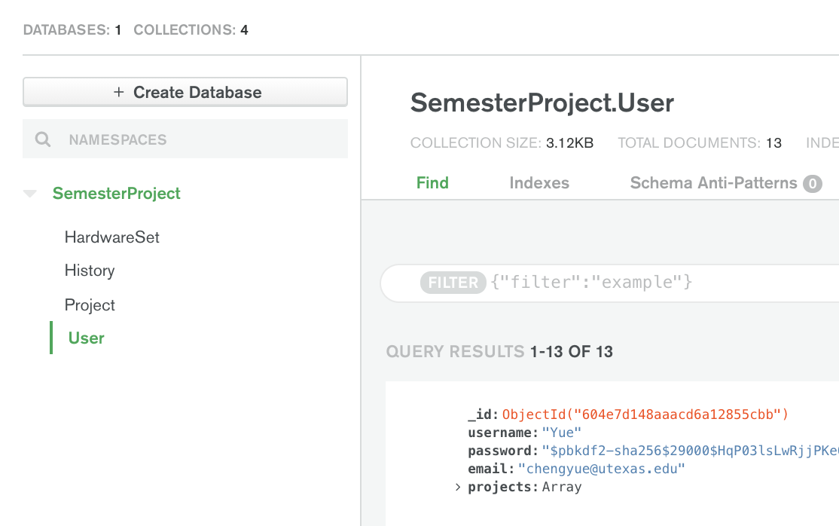
4: Database

Slide 7
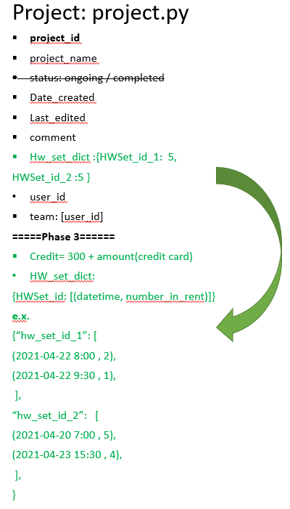
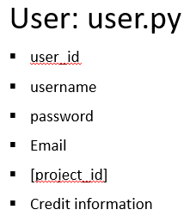
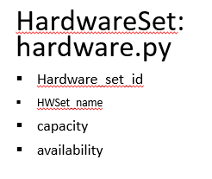
4: Database

Slide 8
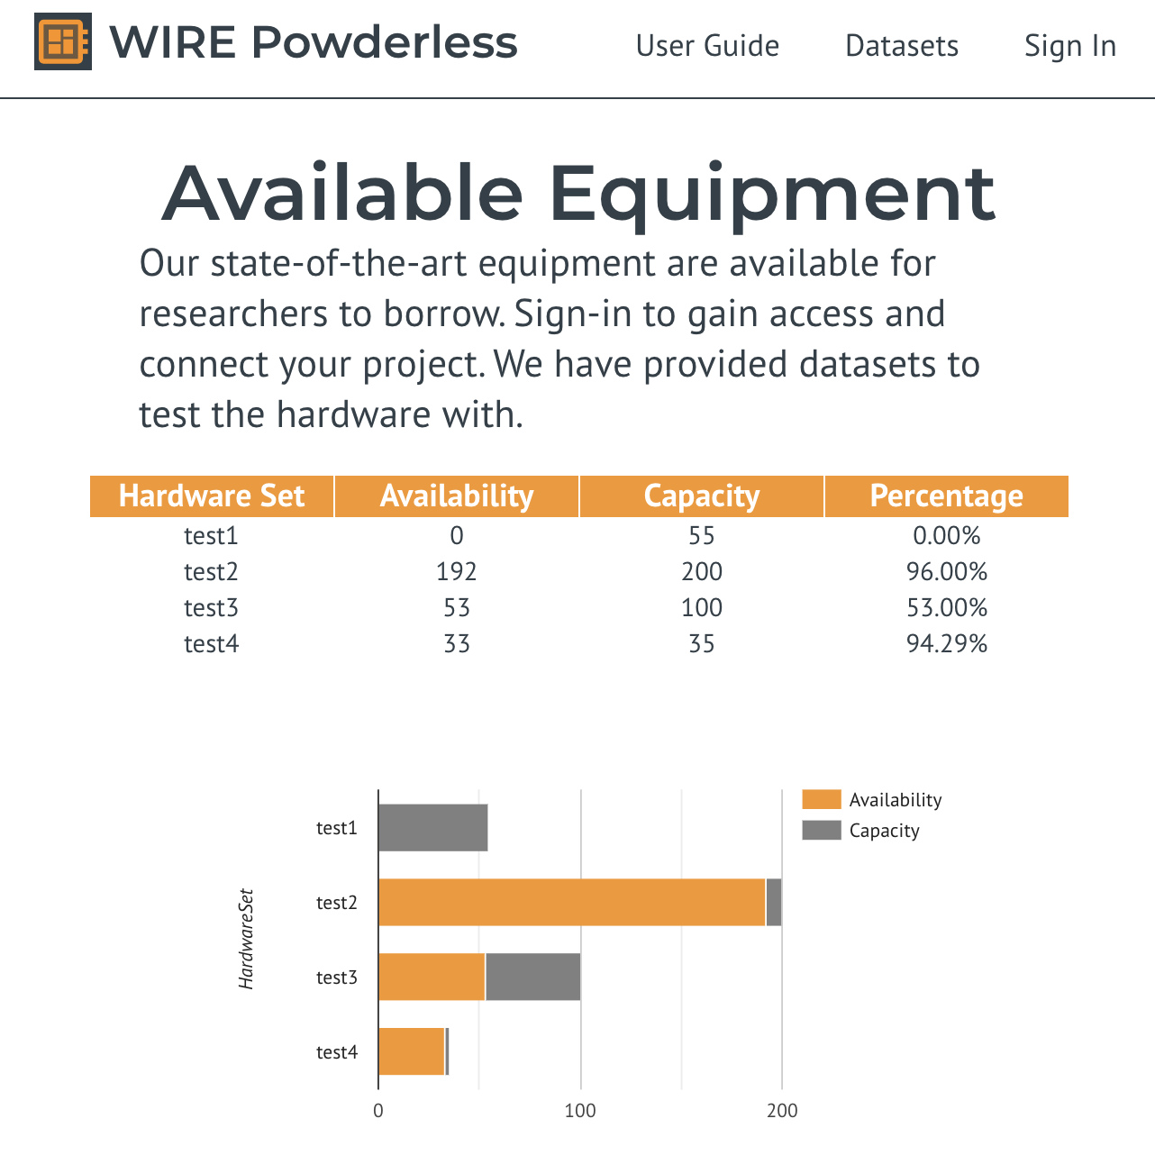
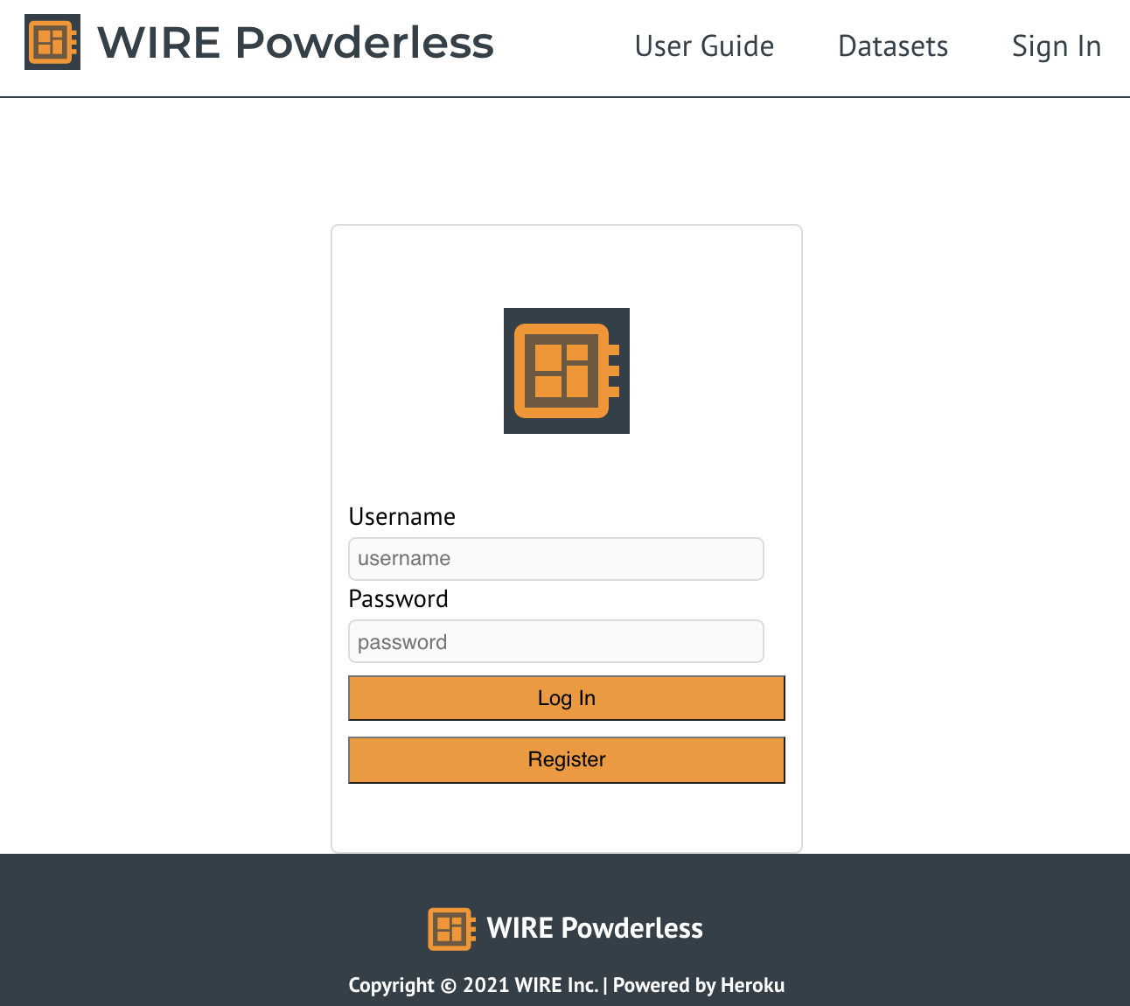
5: Web Development
Frontend: ReactJS
Backend: Flask
Database: MongoDB Atlas
Deployment: Heroku
UI: CSS, Material UI

Slide 9
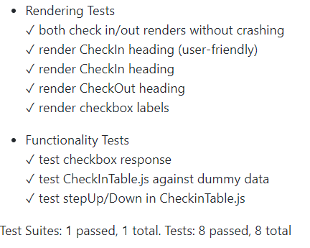
6: Software Testing
Frontend
React Testing Library
Rendering vs functionality

Slide 10
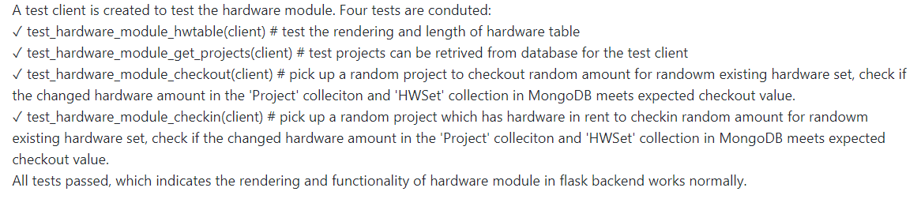
6: Software Testing
Backend
Flask Testing Library, Pytest
Rendering vs functionality

Slide 11
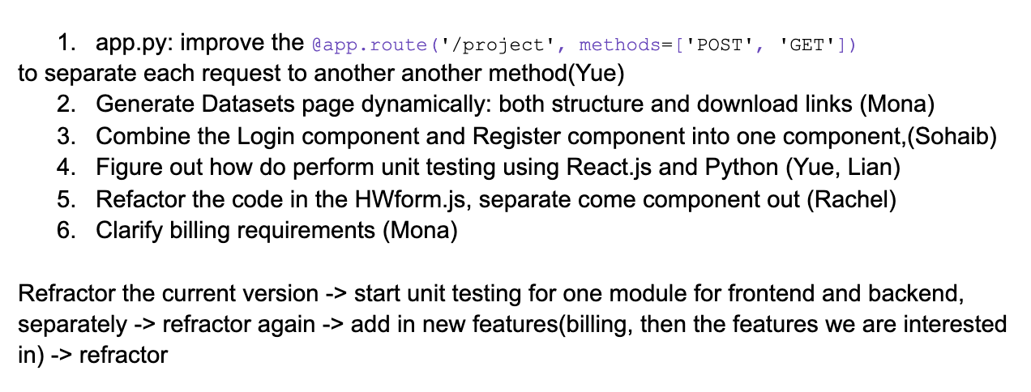
7: Information Hiding and Refactoring

Slide 12
7.1: Refactoring
Frontend
Login Page and Register Page
Dataset Page
Backend
Use Flask blueprint to split app.py into 4 modules

Slide 13
7.2: Information Hiding
Frontend
Hardware page, separate out different forms
Project Page, separate out different components
Backend
In the project_module.py, seperate the codes into helper functions.

Slide 14
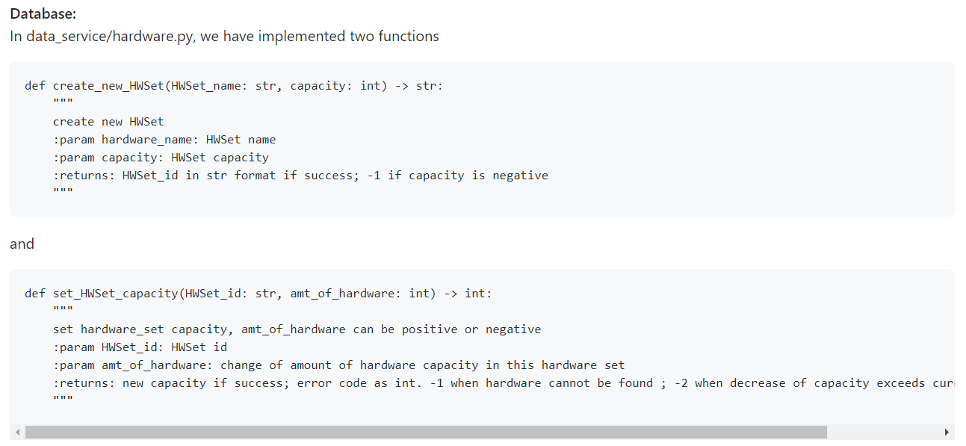
8: Scalability
Add More Hardware Resources

Slide 15
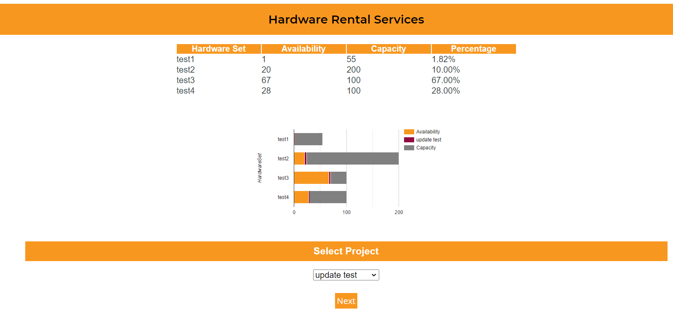
8: Scalability
Add More Hardware Resources

Slide 16
8: Scalability
Tailor the Look and Feel of Web UI by Stakeholders
For more general styling like font style, colors, sizes, and background, make changes to App.css.
For more specific styling of pages or components, make changes to their individual CSS files.

Slide 17
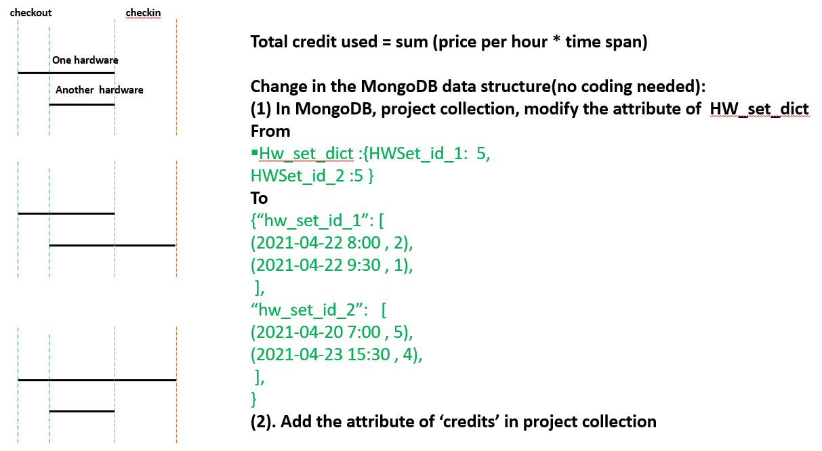
8: Scalability
View Billing Information by Client
Database:

Slide 18
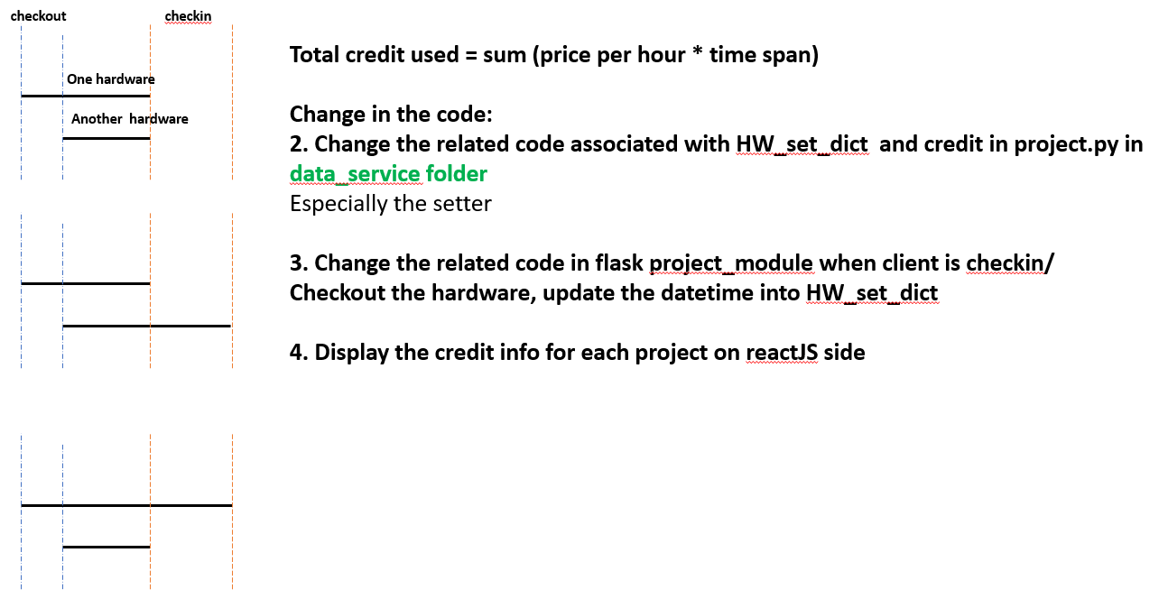
8: Scalability
View Billing Information by Client
Database:

Slide 19
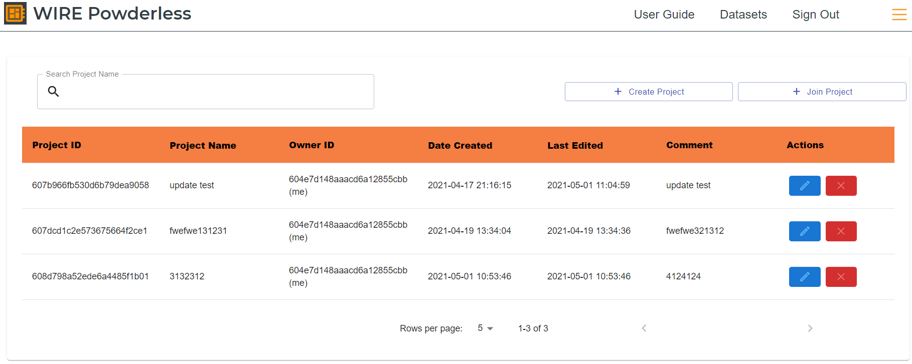
8: Scalability
Web UI
Add a column to indicate the 'credit' amount for each project.
The history of checkin and checkout log can also be stored and displayed if necessary.

Slide 20
8.1 Future Scalability
Implementing custom dataset display:
Use table like with projects page
When projects are created, an extra field where user selects tag about topic
Sort recommended based on projects in dataset page.
Making more datasets available
Change bounds of for loop
Allow changing password
Add an additional field to the edit user info form
Changing Visual Look
Change color and font in our css file
Refactoring CSS
Consolidate the different css files into app.css and change the import statements on relevant .js files.
Specific Project pages
Use the template of the main page which has title at the top with comments, timeline by expanding creation date and last updated to an array in MongoDB, show the same graph as in the hardware set for what you have checked out for the project, replace bios with user info.
Hardwares sets of a type are not interchangeable
Add attribute called “serial number” in MongoDB
Hardware page - multiselect

Slide 21
Module 9 Design Patterns

Slide 22
Module 10: Machine Learning DP

